Slide 1
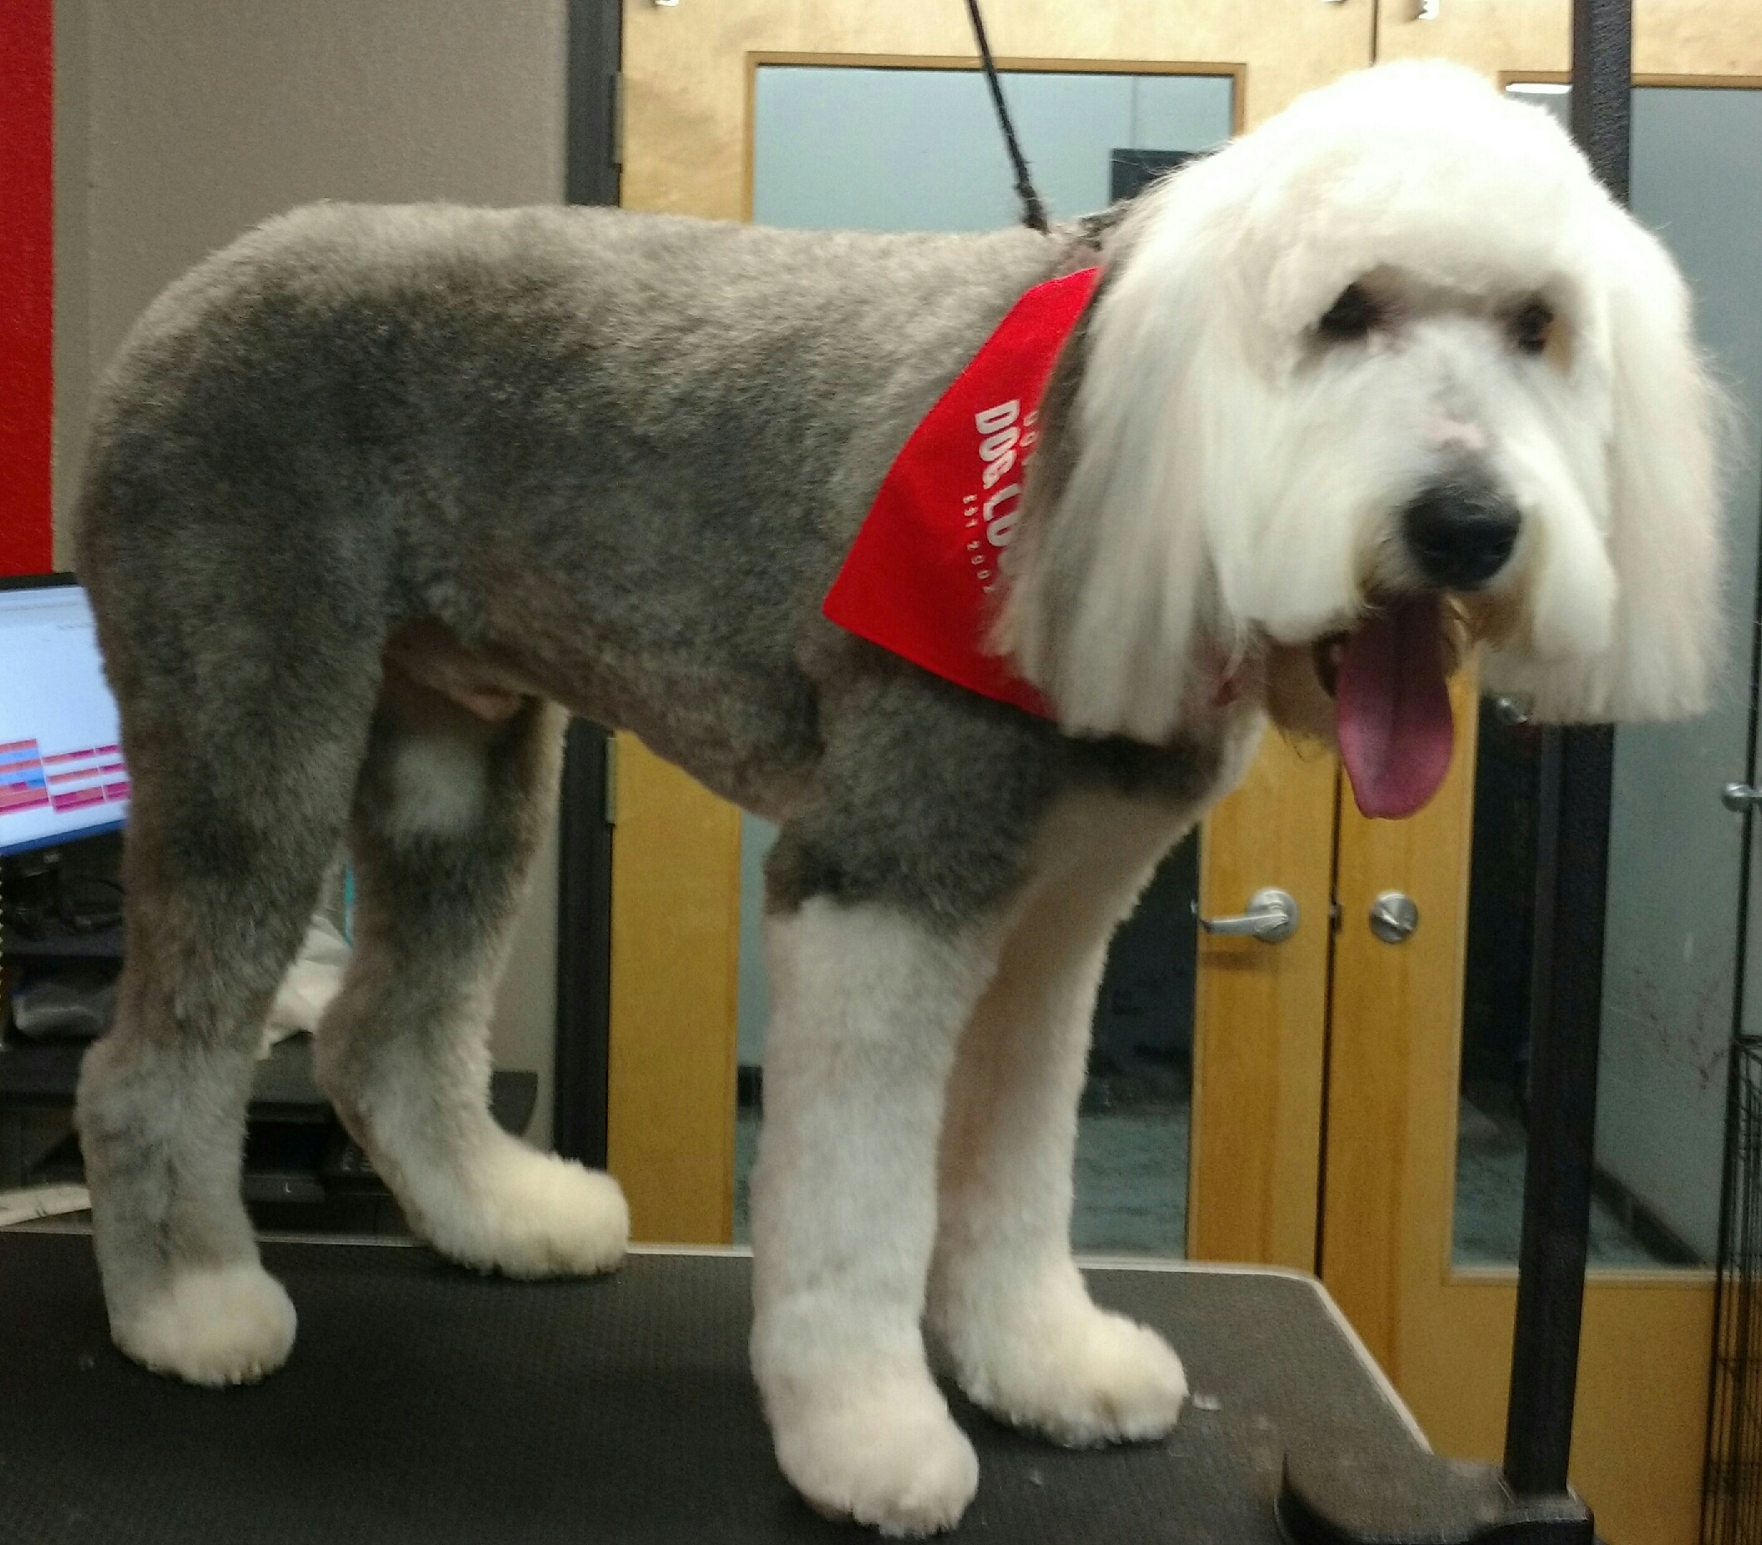
Data Science Methods for Clean Energy Research
Feb 15, 2017
You will need the HCEPD_100K.csv file (or the path to it) for python example time today
Jim’s dog got a haircut and a bath, now has boot-shaped feet

Slide 2
PhD comics on point

Slide 3

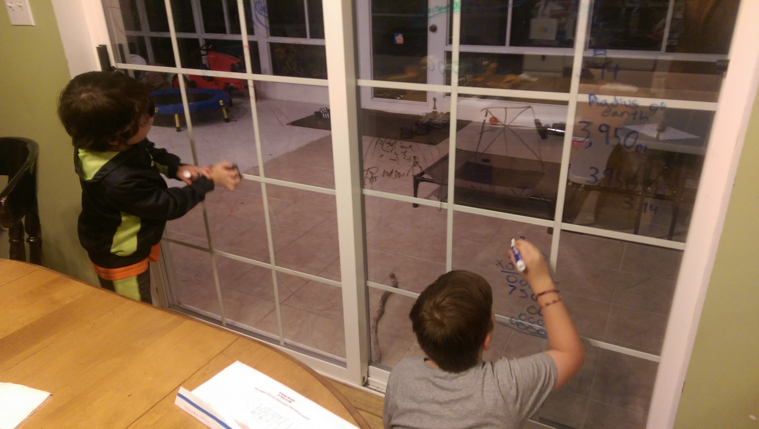
Dave’s dog in his natural habitat: an arm chair
Outline
Simple linear regression
The model
The training
The error
In the coefficients
In the model
Making predictions with the model
Multiple regression
Dave’s kids doing math on the windows.

Slide 4
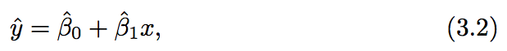
Simple linear regression (SLR)
The regression framework (generic in supervised machine learning)
Propose a model
Define the error metric
Estimate the coefficients and assess the estimate
Determine the error in the model
The humble SLR
Distinguishing the estimates we make with the training data (hat) from the proposed actual coefficients/responses…

Slide 5
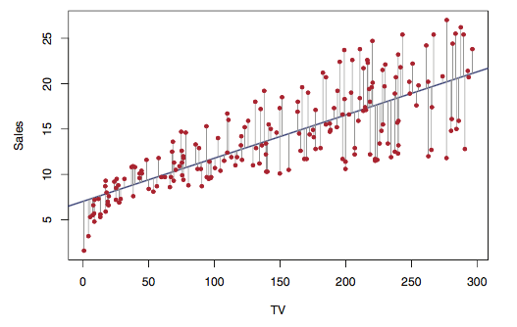
Simple linear regression (SLR)
Residuals
The difference between the observed value of the dependent variable (y) and the predicted value (ŷ) is called the residual (e).
Top: Fig 3.1 ISL

Slide 6
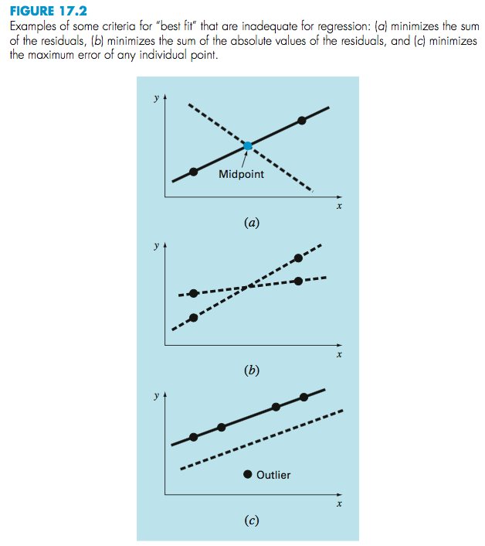
Once the SLR model is known, what is the error?
The SSR describes the sum of squared residual errors, very similar in concept to the MSE we discussed last week
Top: Fig 3.1 ISL
Right: Figure 17.2 from Chapra and Canale numerical methods for Engineers

Slide 7
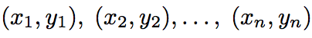
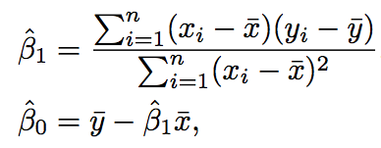
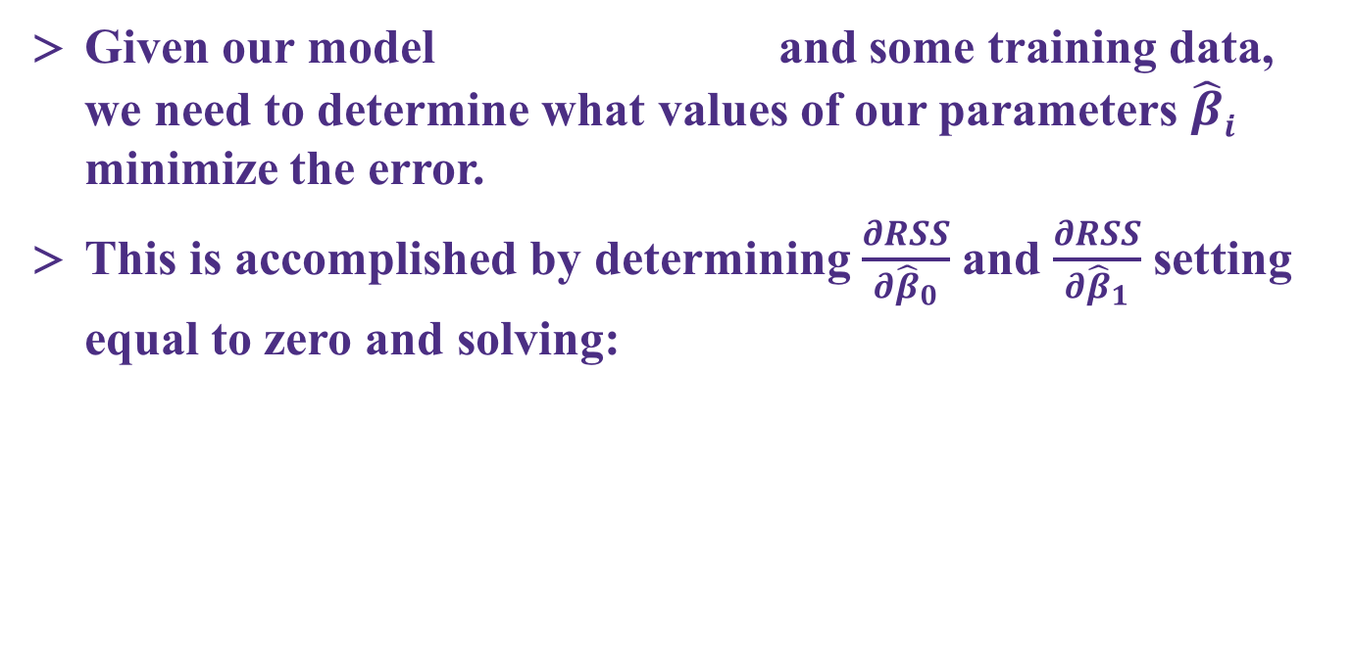
The method of “least squares” minimization
Given our model and some training data, we need to determine what values of our parameters $\hat{β}i$ minimize the error.
This is accomplished by determining $\frac{∂RSS}{∂{\hat{β}}_{0}}$ and $\frac{∂RSS}{∂{\hat{β}}_{1}}$ setting equal to zero and solving:

Slide 8
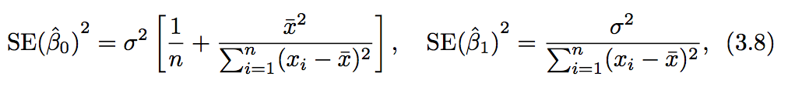
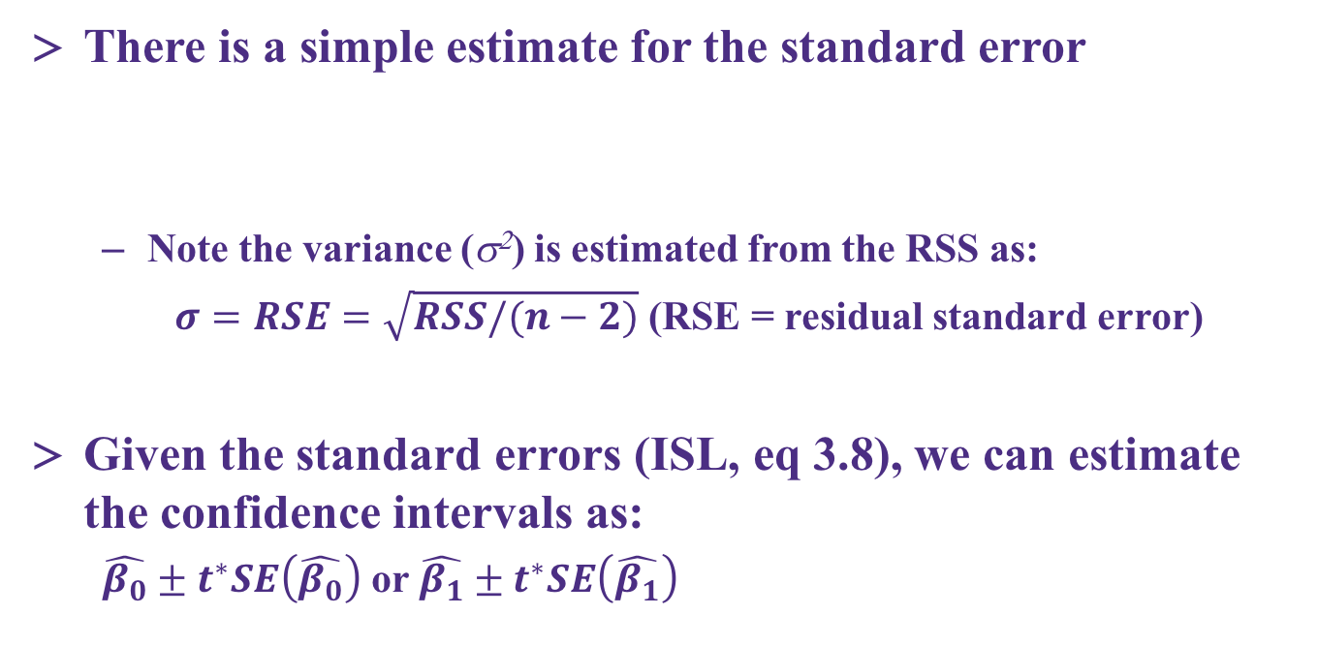
Ways to estimate the uncertainty in the coefficients
There is a simple estimate for the standard error
Note the variance (s²) is estimated from the RSS as:
$σ=RSE=\sqrt{RSS/(n−2)}$ (RSE = residual standard error)
Given the standard errors (ISL, eq 3.8), we can estimate the confidence intervals as:
$\hat{β_{0}}±t^{∗}SE\left(\hat{β_{0}}\right)$ or $\hat{β_{1}}±t^{∗}SE\left(\hat{β_{1}}\right)$

Slide 9
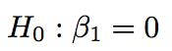
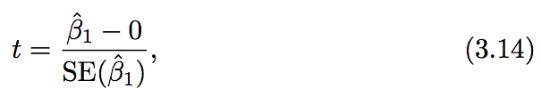
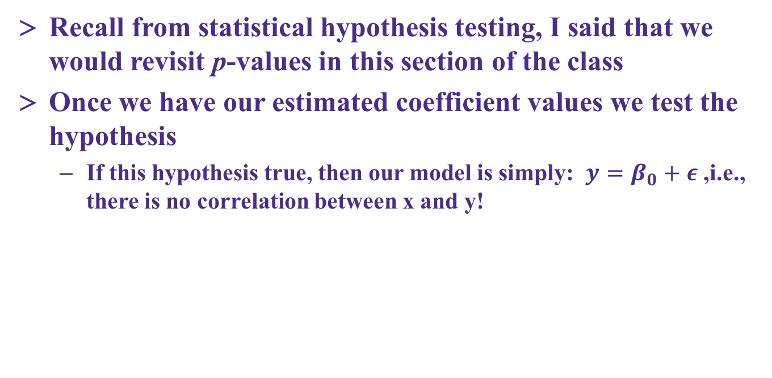
Hypothesis testing on the coefficients
Recall from statistical hypothesis testing, I said that we would revisit p-values in this section of the class
Once we have our estimated coefficient values we test the hypothesis
If this hypothesis true, then our model is simply: $y=β_{0}+ε$ ,i.e., there is no correlation between x and y!

Slide 10
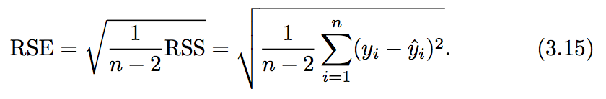
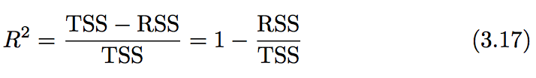
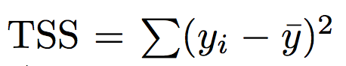
Accuracy of the model – how are we doing overall?
Residual standard error
A measure of the lack of fit of your model (in units of Y!)
R² statistic
A scale invariant measure (0-1 range) that explains ”the proportion of the variability of Y that is explained by X”
TSS measures the total variance in the response Y , and can be squares thought of as the amount of variability inherent in the response before the regression is performed.

Slide 11
Accuracy of the model – how are we doing overall?
R² statistic
A scale invariant measure (0-1 range) that explains ”the proportion of the variability of Y that is explained by X”
TSS measures the total variance in the response Y, and can be squares thought of as the amount of variability inherent in the response before the regression is performed.
RSS is the amount of variability that is left unexplained after performing the regression.
TSS− RSS measures the amount of variability in the response that is explained (or removed) by performing the regression, and R2 measures the proportion of variability in Y that can be explained using X .

Slide 12
Quick example of SLR and P-value calculation with scikit-learn
Grab the notebook for today and practice some SLR

Slide 13
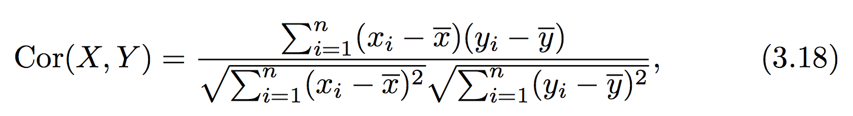
The correlation
(we will need this in multiple regression)
Recall the basic descriptor – correlation coefficient or simply correlation, which we use to describe trends in our data and relationship between variables

Slide 14
Multiple regression
Concept: independently assess the variation in Y with different values of X:
As with SLR, the coefficients are determined by setting the analytical partial derivatives to zero and solving the resultant p+1 linear equations
As with SLR there is an exact solution
Will not show math, but easily found online

Slide 15
Python break /examples
<<instructions>>

Slide 16
Key questions with multi-parameter fits
Section 3.2.2 in ISL does an excellent job of discussing the following four key questions in the context of an MLR fit for marketing/sales data
Is at least one of the predictors X1 , X2 , . . . , Xp useful in predicting the response?
Do all the predictors help to explain Y, or is only a subset of the predictors useful?
How well does the model fit the data?
Given a set of predictor values, what response value should we predict, and how accurate is our prediction?
4 Q directly copied from ISL page 75!

Slide 17
Big picture concepts
Tempting to simply add one term for each feature in X and see how good of a fit we obtain, but that doesn’t give us much inference
There is a huge risk of overfitting with using a lot of parameters!
We can use a new type of hypothesis test to find out if any of the parameters are significant
We can use some algorithms (selection algorithms) to try and reduce the number of parameters

Slide 18
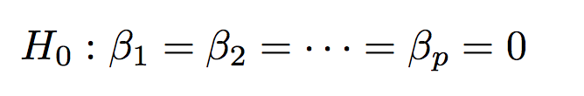
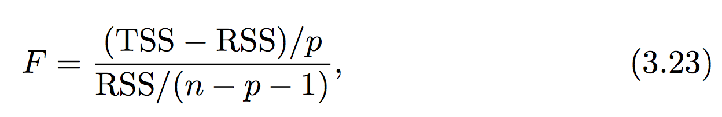
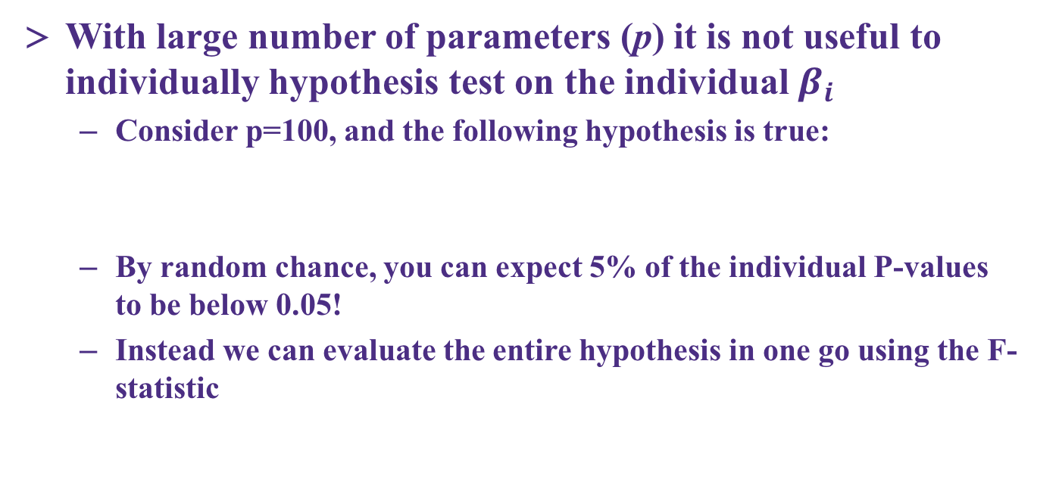
Multiple regression and the F-score
With large number of parameters (p) it is not useful to individually hypothesis test on the individual $β_{i}$
Consider p=100, and the following hypothesis is true:
By random chance, you can expect 5% of the individual P-values to be below 0.05!
Instead we can evaluate the entire hypothesis in one go using the F-statistic

Slide 19
Multiple regression and the F-score
The F-statistic has a penalty for increasing the number of parameters (this should make sense!)
Recall from the t-statistic, we had a specific recipe to test the hypothesis at a certain significance level (e.g., α=0.05)
Similar test is beyond the scope of this class, but you should look for F values: at minimum > 1 as n decreases and p increases the F values to show significance can take values >> 1

Slide 20
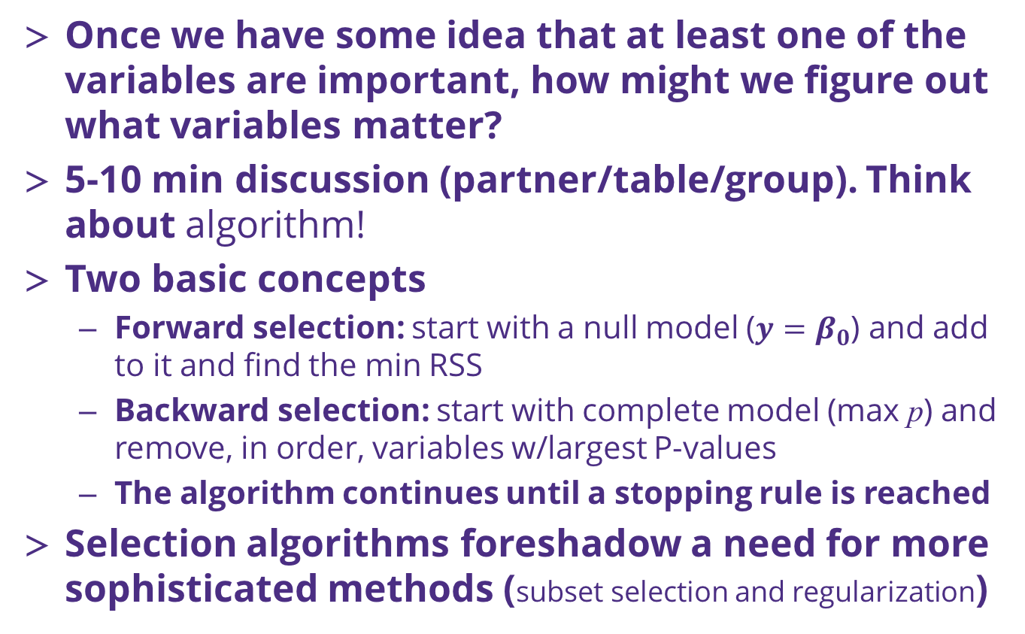
Which of the variables are important?
Once we have some idea that at least one of the variables are important, how might we figure out what variables matter?
5-10 min discussion (partner/table/group). Think about algorithm!
Two basic concepts
Forward selection: start with a null model (${y=β}_{0}$) and add to it and find the min RSS
Backward selection: start with complete model (max p) and remove, in order, variables w/largest P-values
The algorithm continues until a stopping rule is reached
Selection algorithms foreshadow a need for more sophisticated methods (subset selection and regularization)

Slide 21
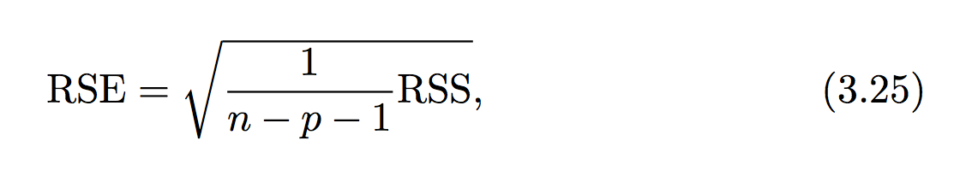
Residual squared error (RSE) in MLR
Our error metric for the goodness of fit of the model also includes a penalty for increasing p compared to n
With an multiple linear regression model in hand, you can make predictions and also trivially add confidence intervals, just as with simple linear regression

Slide 22
When good assumptions go bad
We haven’t discussed it in detail but there are three key assumptions that have been used to build our linear regression model:
Errors are uncorrelated and normally distributed
The variance of the error (in Y) is independent of where we are in X
Liner relationship between X and Y (the predictor-response relationship)
Individual contributions of your X’s are piecewise additive to the response
These assumptions underlie many methods we commonly use!

Slide 23
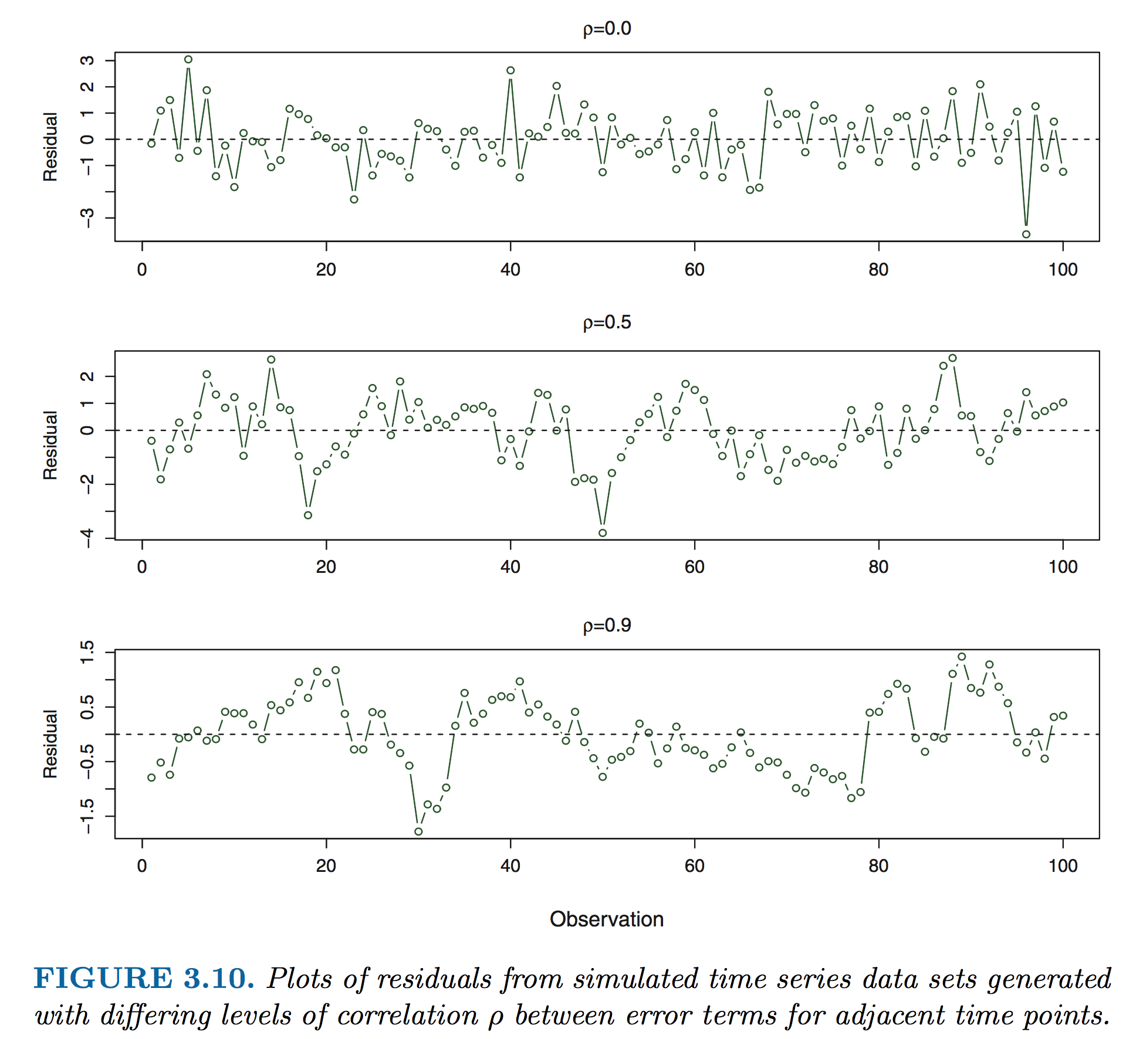
Understanding correlation in error
The most common way that error becomes correlated is with time series data

Slide 24
Identifying correlation in error
Note that the plot in the last slide was residual vs. observation (always a good idea to plot this in addition to a histogram of your residuals – both whether our assumptions are in line)
Introduction and practical implementation of methods to deal w/correlated errors is beyond scope of this class but we can discuss a few principles
The autocorrelation time is the correlation of a signal with a delayed copy of itself as a function of delay.
Fast Fourier transforms (FFT)

Slide 25
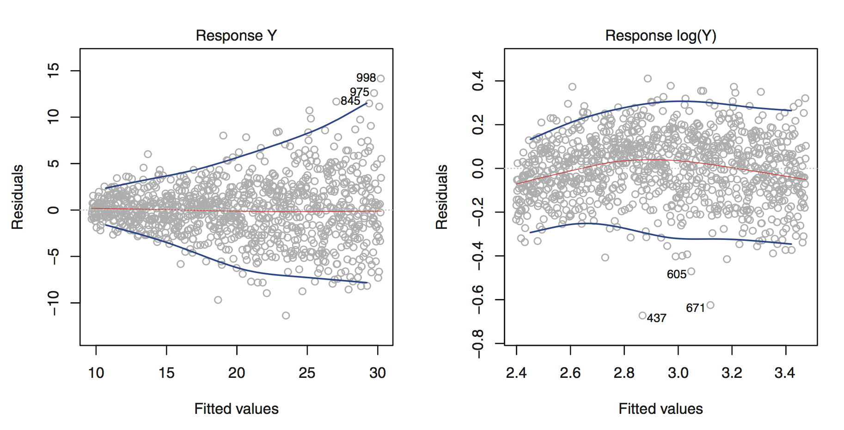
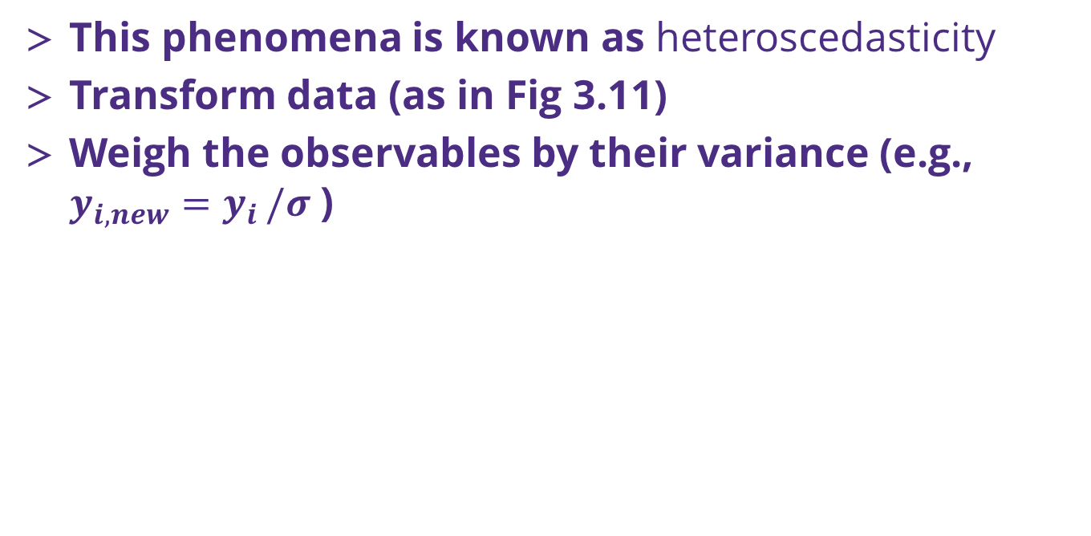
Nonlinear variance
This phenomena is known as heteroscedasticity
Transform data (as in Fig 3.11)
Weigh the observables by their variance (e.g., $y_{i,new}=y_{i }/σ$ )

Slide 26
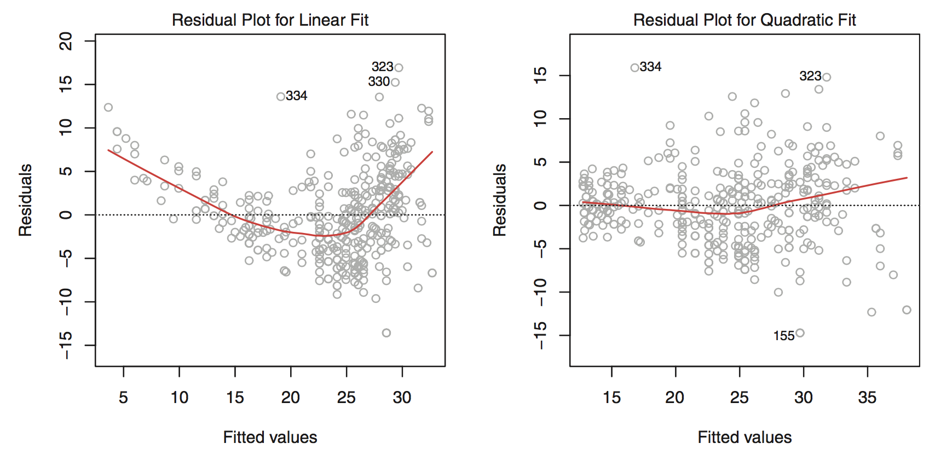
Intro to nonlinear regression
Sometimes your variables have a clear non-linear dependence on the response
This is especially clear when you look at the residuals (ISL Fig 3.9)

Slide 27
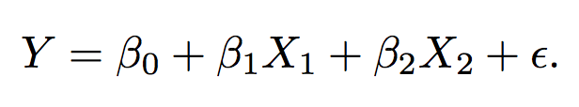
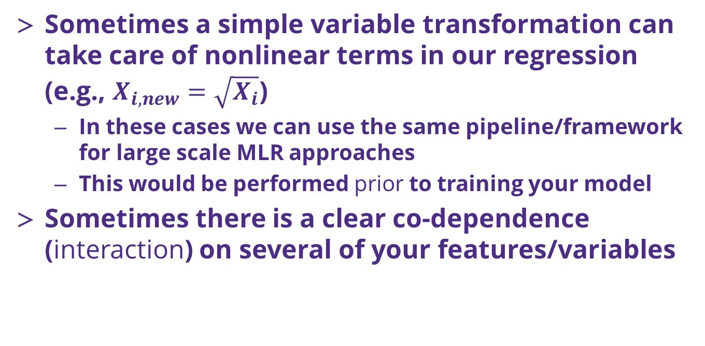
Simple types nonlinear regression
Sometimes a simple variable transformation can take care of nonlinear terms in our regression (e.g., $X_{i,new}=\sqrt{X_{i}}$)
In these cases we can use the same pipeline/framework for large scale MLR approaches
This would be performed prior to training your model
Sometimes there is a clear co-dependence (interaction) on several of your features/variables

Slide 28
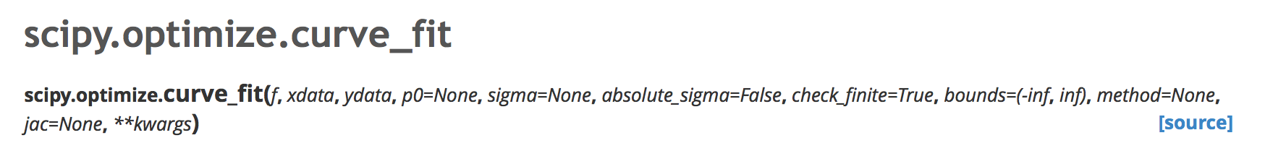
Where to go when you have a true nonlinear model to fit/train?
In general, the packages in scikit-learn work for general linear (single or multiple) or very specific types of nonlinear (e.g., splines) models of Y
The reason why has to do with speed of model solution and large training data set sizes
Other Python packages can also perform regression

Slide 29
Moving from exact solution to finding a minimum MSE
When we leave the world of ”exact solutions”, we are then confined to using numerical solutions to find the minimum value of MSE(β_{i})
Do we need an initial guess? (yes!)
What should it be?
A lot of our machinery for assessing the models still works just fine!

Slide 30
Other topics / suggestions
Chapter 3 of ISL is strongly suggested to read carefully (maybe multiple times)
Additional topics we didn’t cover
Outliers and high leverage points in your training set
Collinearity
More about nonlinear regression
AND MANY MORE!

Slide 31
Resampling methods (CH5, ISL)
Resampling concept
Doing more with your data
A big warning: as introduced today, the resampling schemes are not to be used to generate independent predictions (of Y) for averaging later.
This is a concept related to ‘ensemble’ methods, which we will discuss soon

Slide 32
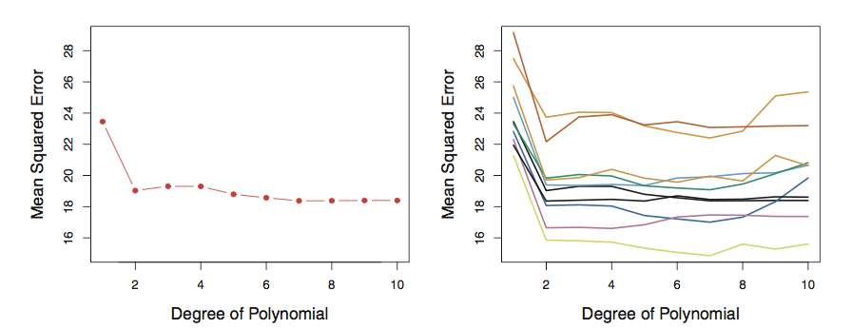
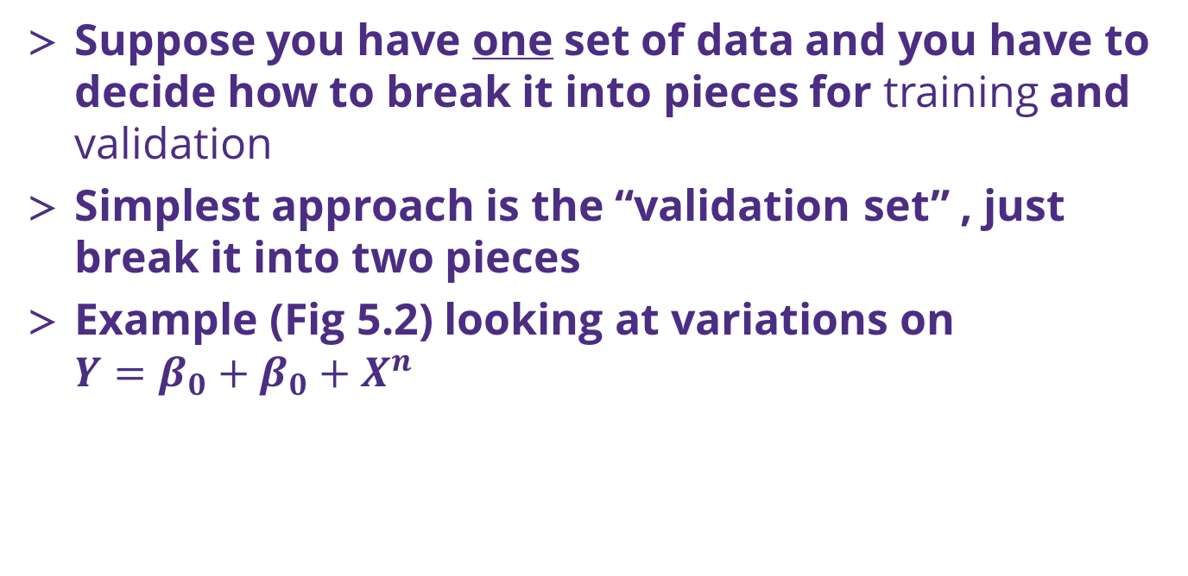
Cross Validation (k-fold)
Suppose you have one set of data and you have to decide how to break it into pieces for training and validation
Simplest approach is the “validation set” , just break it into two pieces
Example (Fig 5.2) looking at variations on $Y=β_{0}+β_{0}+X^{n}$
Left: training MSE vs n for one data set
Right: training MSE vs n for 10 validation sets
Riddle me this, how many ways are there to choose two 500 data sets from 1000?

Slide 33
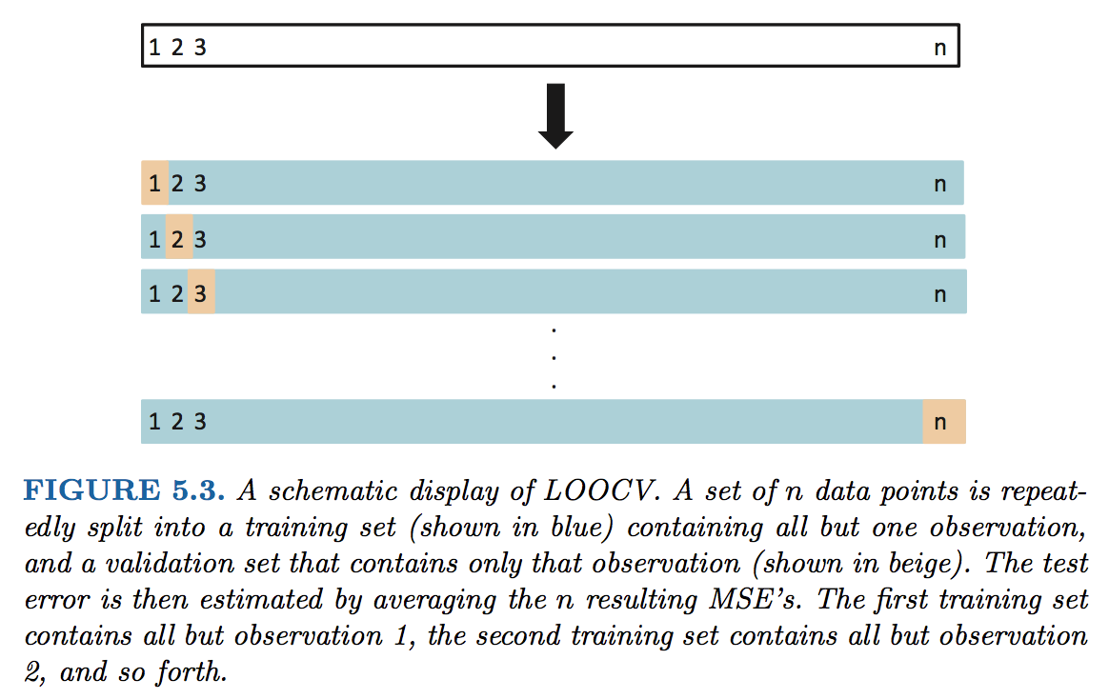
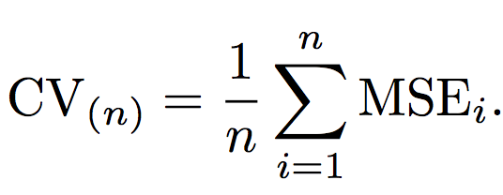
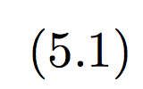
Cross Validation (k-fold)
Since you only use a portion of your data in the training, the ”validation set” approach will tend to overestimate your error!
Leave One Out Cross Validation approach

Slide 34
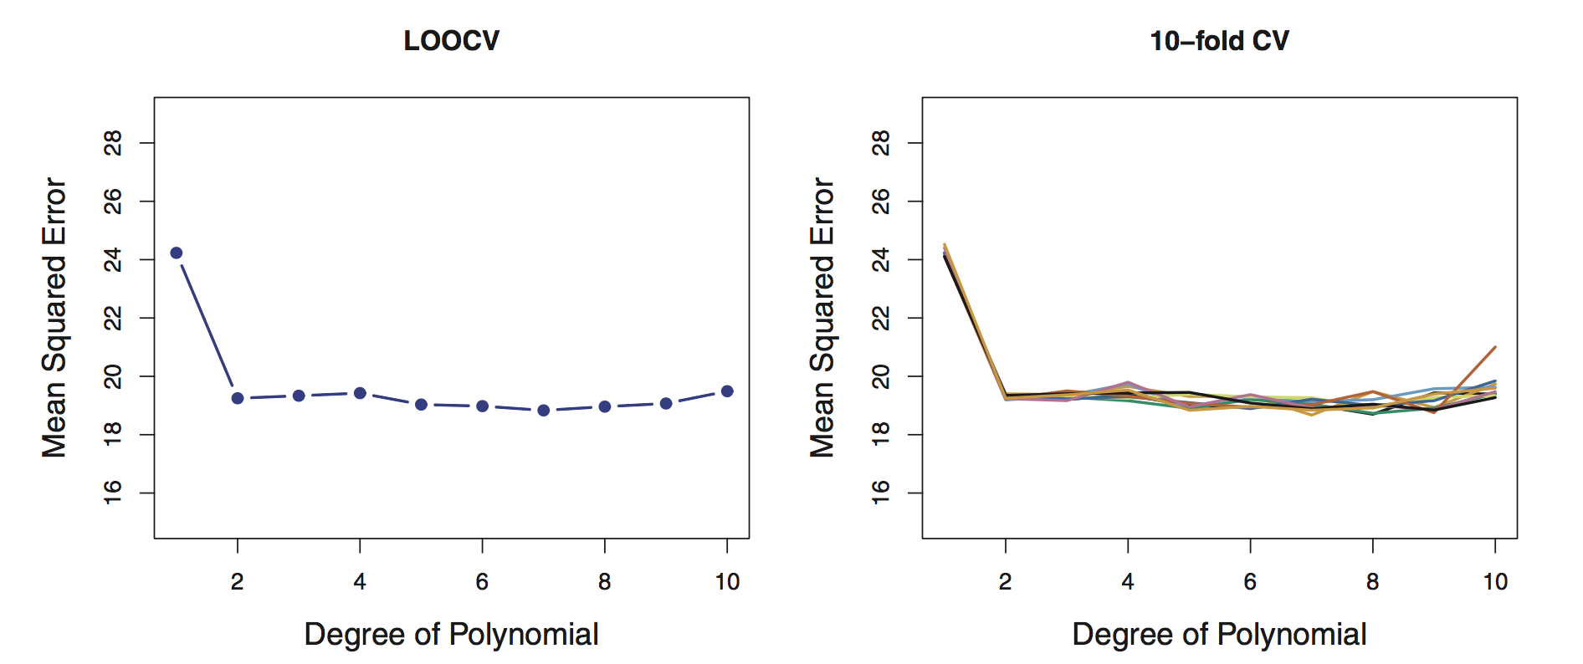
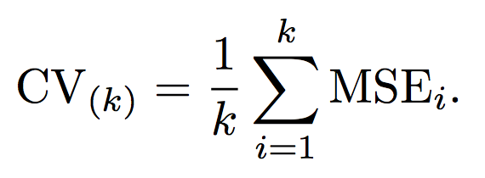
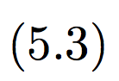
Cross Validation (k-fold)
LOOCV is way more accurate (Fig 5.4), but more computationally expensive!
An alternate is to break the data into larger pieces than n and n-1
We break it into “k” folds of data, e.g. 5-fold. The 1st set is saved for validation, remaining k-1 sets are used for training

Slide 35
Bias/variance tradeoff: use 5 or 10 folds
Bias
an error from erroneous assumptions in the learning algorithm. High bias can cause an algorithm to miss the relevant relations between features and target outputs (underfitting).
Variance
an error from sensitivity to small fluctuations in the training set. High variance can cause an algorithm to model the random noise in the training data, rather than the intended outputs (overfitting).
Bias variance tradeoff relates the simplification of a model to avoid overfitting to the complexity of a model to avoid underfitting.

Slide 36
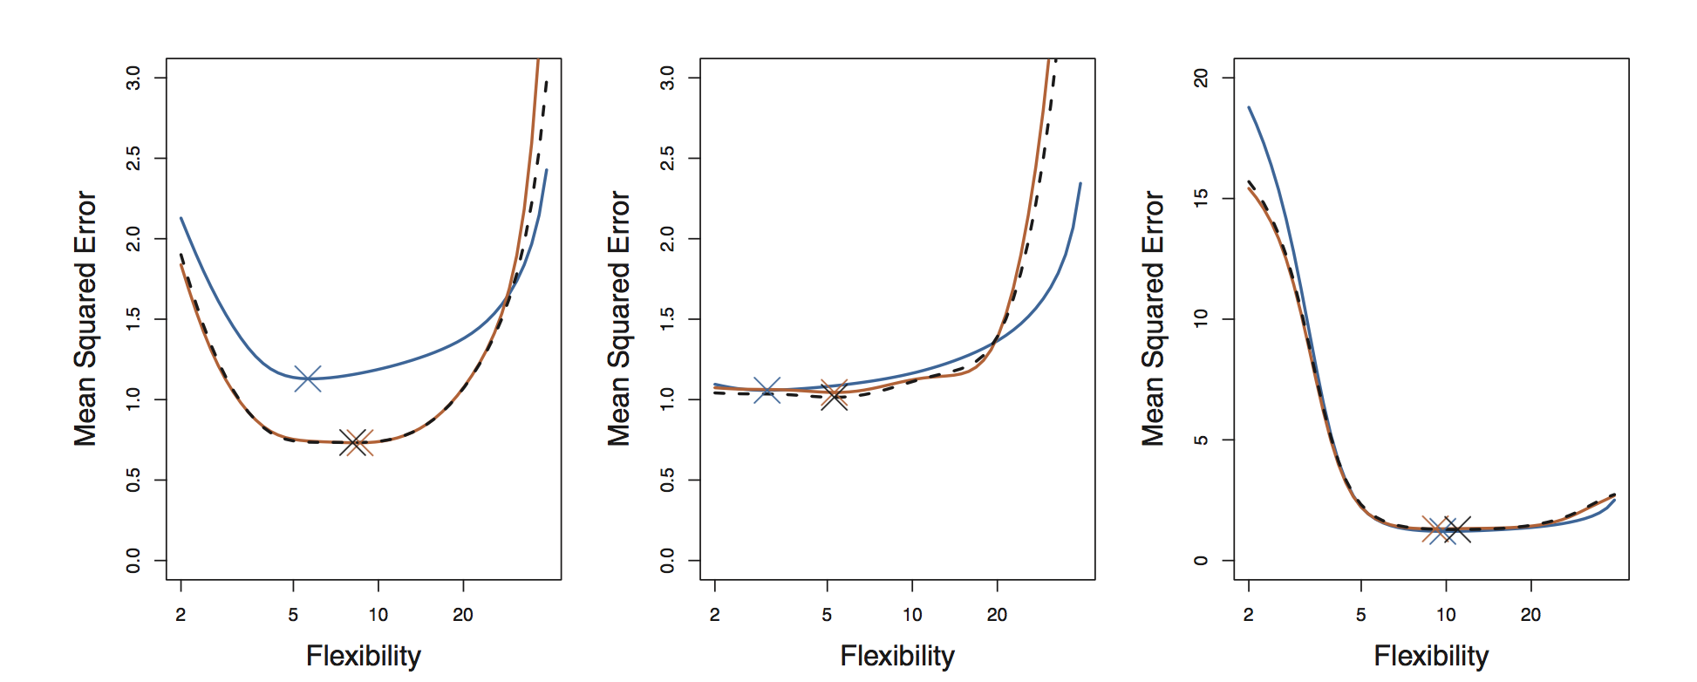
Bias/variance tradeoff: use 5 or 10 folds
Bias
Empirically people usually use 5 or 10 folds to avoid too much bias or variance in their resampling algorithm
This is a great way to get a true estimate of your model’s MSE
Fig 5.6 revisits Fig 2.9 in the context of k-fold cross validation

Slide 37
Bootstrap
The bootstrap is one of the most versatile tools you will use in statistical analysis of data sets
It involves resampling with replacement from your data set
Algorithm:
Randomly draw, with replacement, some subset from your training data
Train your model and make an estimate of your coefficient and MSE
Rinse and repeat until the errors converge

Slide 38
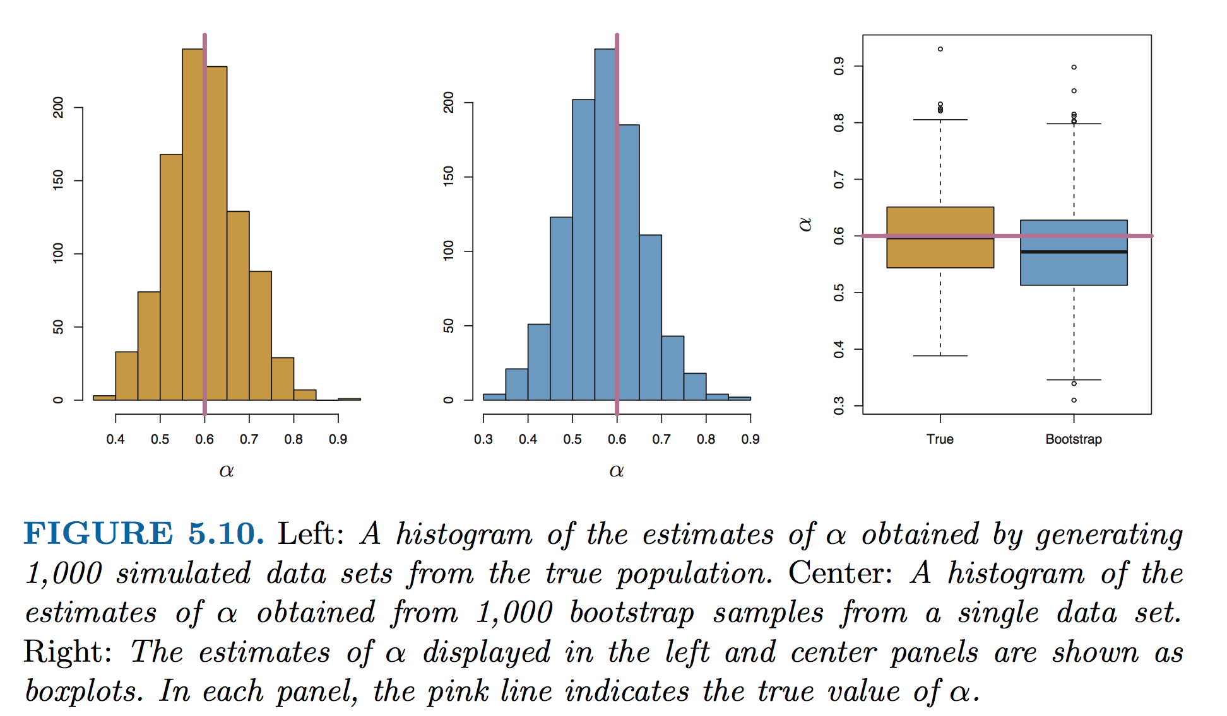
The power of the bootstrap in one figure
Fig 5.10, estimates of some parameter, α

Slide 39
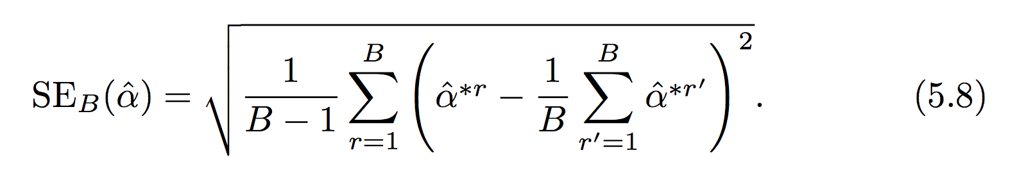
Take care
Depending on how large your bootstrap sample data set is, I recommend you avoid using the standard error formula (Eq 5.8) and instead you should use simply the standard deviation of the bootstrap estimates.
Can anyone explain why?
In this context α, could be any quantity from your training procedure (MSE, β, etc..)

Slide 40
What’s next?
HW 4!
Should be available by the end of the day.

